Slide 1
ECEG-5193: Algorithm Analysis and Design
Recurrences
Recursive Equations

Slide 2
3. Recurrences
ECEG 5193

Slide 3
Recurrence
void Test(int n)
{
if(n>0)
{
printf(“/d”,n);
Test(n-1);
}
}
void main()
{
Test(3);
}
Test(3)
3
Test(2)
4
function
calls
2
Test(1)
= n+1
1
Test(0)
T(n) = O(n)
3 – Printfs
= n

Slide 4








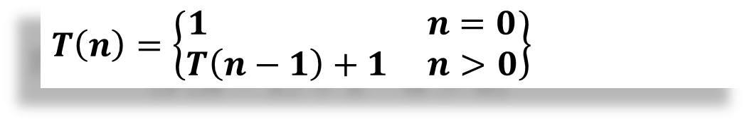











Recurrence: Iteration.
$$T\left(n\right)=\left\{\begin{matrix}1 n=0 \\ T\left(n−1\right)+1 n>0\end{matrix}\right\}$$
void Test(int n)
{
if(n>0)
{
printf(“/d”,n);
Test(n-1);
}
}
void main()
{
Test(3);
}
T(n)
$$T\left(n\right)= T\left(n−1\right)+1$$
$$T\left(n−1\right)= T\left(n−2\right)+1$$
1
$$T\left(n\right)=T\left(n−2\right)+1+1$$
$$T\left(n\right)=T\left(n−2\right)+2$$
$$T\left(n−2\right)= T\left(n−3\right)+1$$
1
$$T\left(n\right)=T\left(n−3\right)+1+2$$
T(n-1)
$$T\left(n\right)=T\left(n−3\right)+3$$
$$T\left(n−3\right)= T\left(n−4\right)+1$$
$$T\left(n\right)=T\left(n−4\right)+1+3$$
$$\left(n−k\right)=0$$
$$T\left(n\right)=T\left(n−4\right)+4$$
$$n=k$$
$$T\left(n\right)=T\left(n−k\right)+k$$
$$T\left(n\right)=T\left(n−k\right)+k$$
$$T\left(n\right)=T\left(0\right)+k$$
$$Terminates when$$
$$T\left(n\right)=1+n$$
$$\left(n−k\right)=0$$
$$T\left(n\right)=O(n)$$

Slide 5


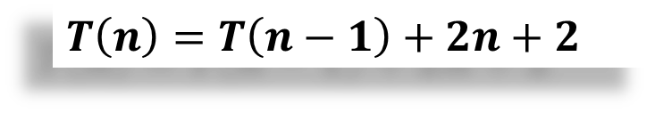

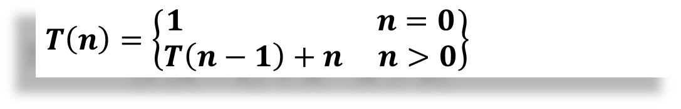





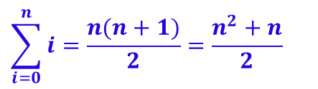

Recurrence
$$T\left(n\right)=\left\{\begin{matrix}1 n=0 \\ T\left(n−1\right)+n n>0\end{matrix}\right\}$$
void Test(int n)
{
if(n>0)
{
for(i=0;i<n;i++)
{
printf(“/d”,n);
}
Test(n-1);
}
}
T(n)
$$T\left(n\right)= T\left(n−1\right)+n$$
1
$$T\left(n−1\right)= T\left(n−2\right)+(n−1)$$
$$T\left(n\right)=T\left(n−2\right)+(n−1)+n$$
n+1
$$T\left(n−2\right)= T\left(n−3\right)+(n−2 )$$
$$T\left(n\right)=T\left(n−3\right)+\left(n−2\right)+(n−1)+n$$
$$T\left(n−3\right)= T\left(n−4\right)+(n−3 )$$
n
$$T\left(n\right)=T\left(n−4\right)+(n−3)+(n−2)+(n−1)+n$$
$T(n)=T\left(n−k\right)+$($n−k+1)+…+(n−2)+(n−1)+n$
T(n-1)
$$Terminates when$$
$$T\left(n\right)=T\left(n−k\right)+…+n−1+n$$
$$\left(n−k\right)=0$$
$$=T\left(0\right)+T\left(1\right)+…+n−1+n$$
$$n=k$$
$$=1+2+…+n−1+n$$
$$T\left(n\right)=T\left(n−1\right)+2n+2$$
$$\sum_{i=0}^{n}{i}=\frac{n(n+1)}{2}=\frac{n^{2}+n}{2}$$
$$T\left(n\right)=O(n2)$$

Slide 6


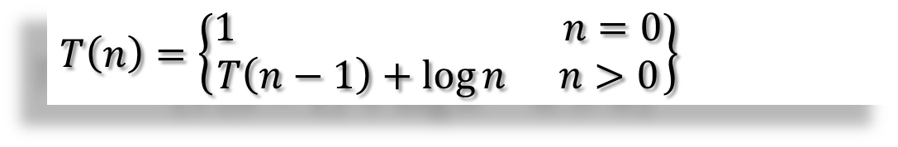




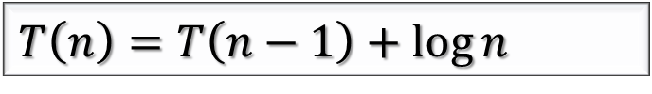
Recurrence
$$T\left(n\right)=\left\{\begin{matrix}1 n=0 \\ T\left(n−1\right)+\log{n} n>0\end{matrix}\right\}$$
void Test(int n)
{
if(n>0)
{
for(i=0;i<n;i=i*2)
{
printf(“/d”,n);
}
Test(n-1);
}
}
T(n)
$$T\left(n\right)= T\left(n−1\right)+\log{n}$$
$$T\left(n−1\right)= T\left(n−2\right)+ log{(n−1)}$$
$$T\left(n\right)=T\left(n−2\right)+ log{(n−1)}+\log{n}$$
$$T\left(n−2\right)=T\left(n−3\right)+ log{(n−2)}$$
$$T\left(n\right)=T\left(n−3\right)+ log{(n−2)}+ log{(n−1)}+\log{n}$$
log n
$$T\left(n\right)=T\left(n−k\right)+ log\left(n−(k−1)\right)+…+ log{(n−1)}+\log{n}$$
$$let n=k$$
$$T\left(n\right)=T\left(0\right)+ log\left(n−(k−1)\right)+…+ log{(n−1)}+\log{n}$$
T(n-1)
$$=1+\log{1}+\log{2}+…+\log{(n−1)}+\log{n}$$
$$=1+\log{(1∗2∗3∗…∗\left(n−2\right)∗\left(n−1\right)∗n)}$$
$$=1+\log{(n!)}$$
$$T\left(n\right)=T\left(n−1\right)+\log{n}$$
$$=1+\log{(nn)}$$
$$T\left(n\right)=O(\operatorname{nlog}{(n)})$$
$$=1+\operatorname{nlog}{(n)}$$

Slide 7







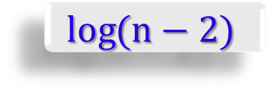
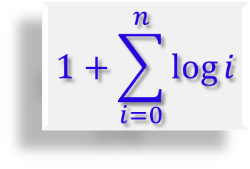
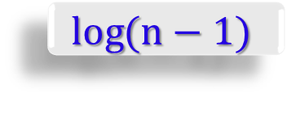



Recurrence
$$T\left(n\right)=\left\{\begin{matrix}1 n=0 \\ T\left(n−1\right)+\log{n} n>0\end{matrix}\right\}$$
void Test(int n)
{
if(n>0)
{
for(i=0;i<n;i=i*2)
{
printf(“/d”,n);
}
Test(n-1);
}
}
T(n)
$$\log{n}$$
T(n)
$$\log{(n−1)}$$
T(n-1)
$$\log{(n−2)}$$
T(n-2)
$$\log{2}$$
T(2)
log n
$$\log{1}$$
T(1)
$$1$$
T(0)
T(n-1)
$=$ $1+\log{2}+…+\log{(n−1)}+\log{n}$
$$1+\sum_{i=0}^{n}{\log{i}}$$
$$=1+\log{(1∗2∗…∗\left(n−1\right)∗n)}$$
$$=1+\log{(n!)}$$
$$=1+\log{(nn)}$$
$$T\left(n\right)=O(n log{(n)})$$
$$T\left(n\right)=T\left(n−1\right)+\log{n}$$
$$=1+\operatorname{nlog}{(n)}$$

Slide 8
Recurrence Relation
T(n) = T(n -1) +1
O(n)
T(n) = T(n -1) + n
O(n²)
T(n) = T(n -1) + log n
O(n log n)
T(n) = T(n -1) + n²
O(n³)
T(n) = T(n -2) +1
O(n)
T(n) = T(n -100) +1
O(n)
T(n) = 2T(n -1) +1
?

Slide 9

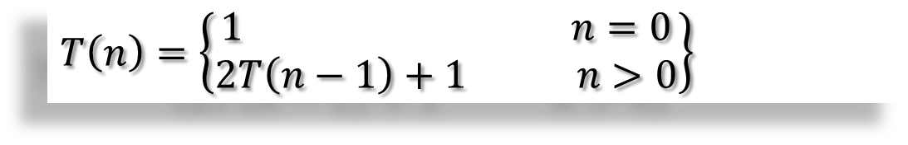





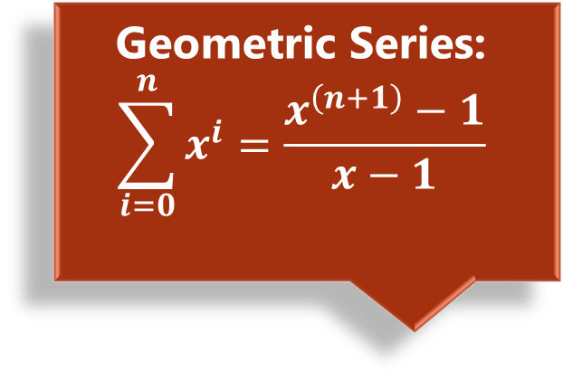
$$T\left(n\right)=\left\{\begin{matrix}1 n=0 \\ 2T\left(n−1\right)+1 n>0\end{matrix}\right\}$$
void Test(int n)
{
if(n>0)
{
printf(“/d”,n);
Test(n-1);
Test(n-1);
}
}
T(n)
Test(n)
1 = 2⁰
Test(n-1)
Test(n-1)
2 = 2¹
Test(n-2)
Test(n-2)
Test(n-2)
Test(n-2)
4 = 2²
1
8 = 2³
$$\text{Geometric} \text{Series}\text{:}$$
$$\sum_{i=0}^{n}{x^{i}}=\frac{x^{\left(n+1\right)}−1}{x−1}$$
T(n-1)
T(n-1)
16 = 2⁴
x = 2^{k}
$$T\left(n\right)=1+2+22+…+2k$$
$$=2^{k+1}−1$$
$$T\left(n\right)=2T\left(n−1\right)+1$$
$$when n=k$$
$${ T\left(n\right)=2}^{n+1}−1$$
$${ T\left(n\right)=O(2}^{n})$$
Notes:
Geometric Series: Let x ≠ 1 be any constant (independent of n), then for n ≥ 0,
$$\sum_{i=0}^{n}{x^{i}}=x+x^{2}+x^{3}+ …+x^{n}=\frac{x^{\left(n+1\right)}−1}{x−1}$$

Slide 10
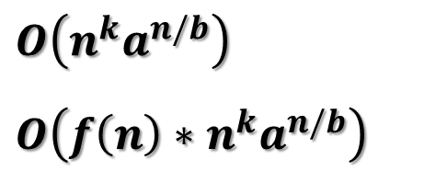

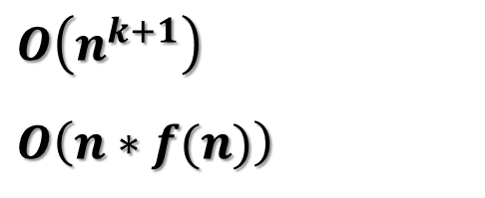
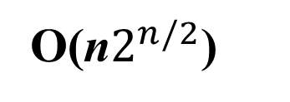
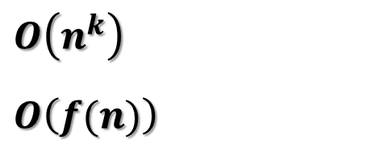


Recurrence Relation
Master theorem for decreasing functions.
T(n) = T(n -1) +1
O(n)
$$T\left(n\right)=aT\left(n−b\right)+f(n)$$
T(n) = T(n -1) + n
O(n²)
$$a>0, b>0 and f\left(n\right)=O\left(nk\right)where k≥0$$
T(n) = T(n -1) + log n
O(n log n)
$$O\left(n^{k}\right)$$
$$O\left(f(n)\right)$$
T(n) = T(n -1) + n²
O(n³)
Case 1 | $$a<1$$
T(n) = T(n -2) +1
O(n)
T(n) = T(n -100) +1
O(n)
$$O\left(n^{k+1}\right)$$
$$O\left(n∗f(n)\right)$$
Case 2 | $$a=1$$
T(n) = 2T(n -1) +1
O(2^{n})
T(n) = 3T(n -1) +1
O(3^{n})
$$O\left(n^{k}a^{n/b}\right)$$
$$O\left(f\left(n\right)∗n^{k}a^{n/b}\right)$$
T(n) = 2T(n -1) + n
O(n2^{n})
Case 3 | $$a>1$$
T(n) = 2T(n -2) + n
O(n$2^{n/2}$)

Slide 11
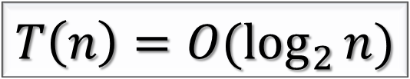
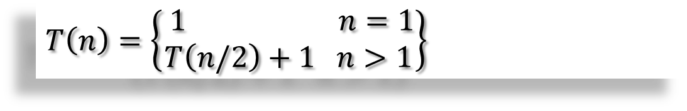
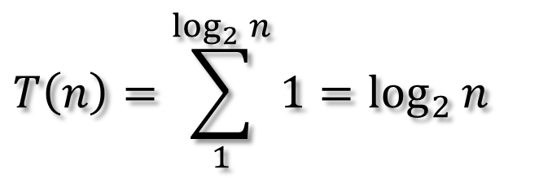

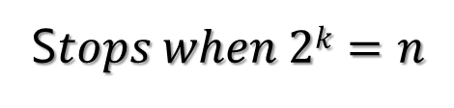
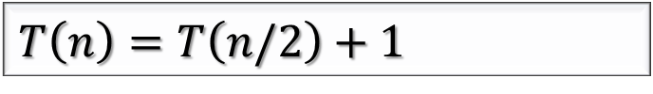
$$T\left(n\right)=\left\{\begin{matrix} 1 n=1 \\ T\left(n/2\right)+1 n>1\end{matrix}\right\}$$
void Test(int n)
{
if(n>0)
{
printf(“/d”,n);
Test(n/2);
}
}
T(n)
T(n)
1
T(n/2)
1
T(n/2²)
1
1
S$tops when 2k=n$
T(n/2)
T(n/2^{k})
1
$$k=\log_{2}{n}$$
$$T\left(n\right)=\sum_{1}^{\log_{2}{n}}{1}=\log_{2}{n}$$
$$T\left(n\right)=T\left(n/2\right)+1$$
$$T\left(n\right)=O(\log_{2}{n})$$

Slide 12
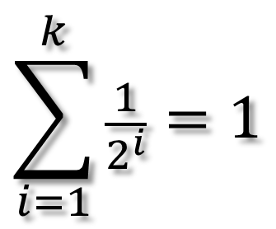

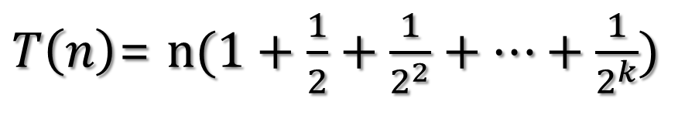
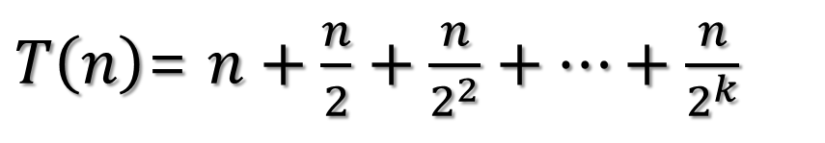
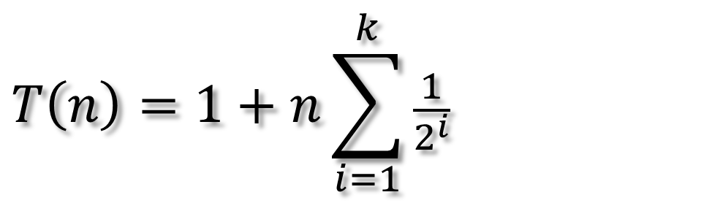
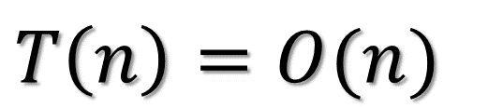
Recurrence Relation
$$T\left(n\right)=\left\{\begin{matrix} 1 n=1 \\ T\left(n/2\right)+n n>1\end{matrix}\right\}$$
T(n)
n
$$T\left(n\right)=1+n\sum_{i=1}^{k}{\frac{1}{2^{i}}}$$
T(n/2)
n/2
T(n/2²)
n/2²
$$\sum_{i=1}^{k}{\frac{1}{2^{i}}}=1$$
T(n/2^{k})
n/2^{k}
$T\left(n\right)$= $n+\frac{n}{2}+\frac{n}{2^{2}}+…+\frac{n}{2^{k}}$
$T\left(n\right)$= $n(1+\frac{1}{2}+\frac{1}{2^{2}}+…+\frac{1}{2^{k}})$
$$T\left(n\right)=O(n)$$

Slide 13
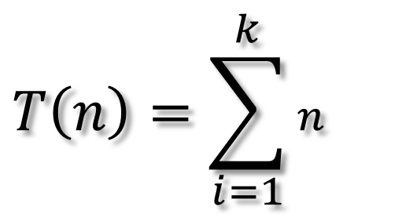
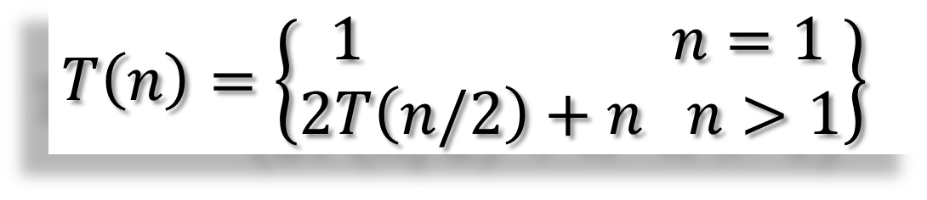
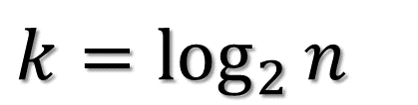
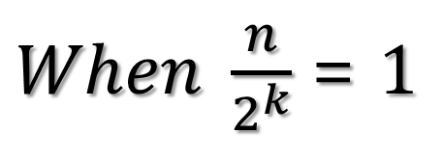
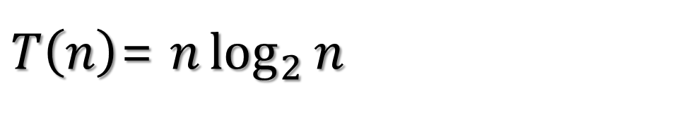
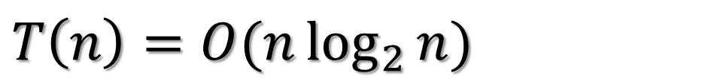
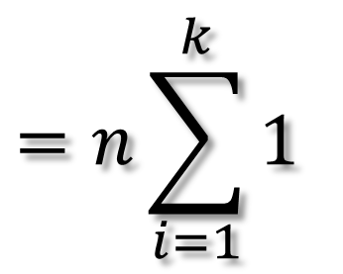
Recurrence Relation
$$T\left(n\right)=\left\{\begin{matrix} 1 n=1 \\ 2T\left(n/2\right)+n n>1\end{matrix}\right\}$$
T(n)
n
$When \frac{n}{2^{k}}$= $1$
$$k=\log_{2}{n}$$
T(n/2)
T(n/2)
n
$$T\left(n\right)=\sum_{i=1}^{k}{n}$$
$$=n\sum_{i=1}^{k}{1}$$
T(n/2²)
T(n/2²)
T(n/2²)
T(n/2²)
n
$T\left(n\right)$= $n\log_{2}{n}$
T(n/2^{k})
T(n/2^{k})
n
$$T\left(n\right)=O(n\log_{2}{n})$$

Slide 14

Recurrence Relation
Exercise
$$Given T\left(n\right)=\left\{\begin{matrix} 1 n=1 \\ T\left(\sqrt{n}\right)+n n>1\end{matrix}\right\}$$
$$Show that T\left(n\right)=O(\log{\log{n}})$$

Slide 15
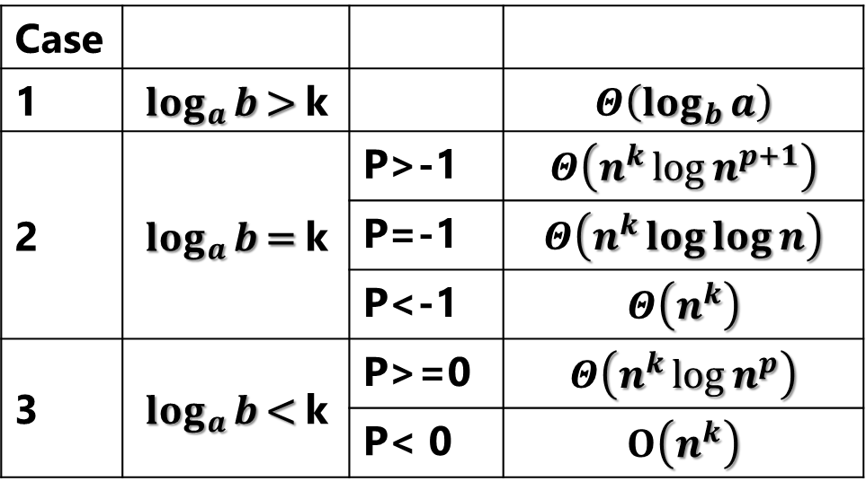
Master Theorem for Dividing Functions
$$T\left(n\right)=aT\left(n/b\right)+f(n)$$
$$a≥1, b>0 and f\left(n\right)=Θ\left(n^{k}\log_{n}{p}\right) where k≥0$$
Case
1 | $$\log_{a}{b}\text{> }\text{k}$$ |  | $$Θ\left(\log_{b}{a}\right)$$
2 | $$\log_{a}{b}\text{= }\text{k}$$ | P>-1 | $$Θ\left(n^{k}{\log{n}}^{p+1}\right)$$
 | $$\log_{a}{b}\text{= }\text{k}$$ | P=-1 | $$Θ\left(n^{k}\log{\log{n}}\right)$$
 | $$\log_{a}{b}\text{= }\text{k}$$ | P<-1 | $$Θ\left(n^{k}\right)$$
3 | $$\log_{a}{b}\text{< }\text{k}$$ | P>=0 | $$Θ\left(n^{k}{\log{n}}^{p}\right)$$
 | $$\log_{a}{b}\text{= }\text{k}$$ | P< 0 | $$O\left(n^{k}\right)$$

Slide 16
Recurrence
A function that is defined with respect to itself on smaller inputs

Slide 17
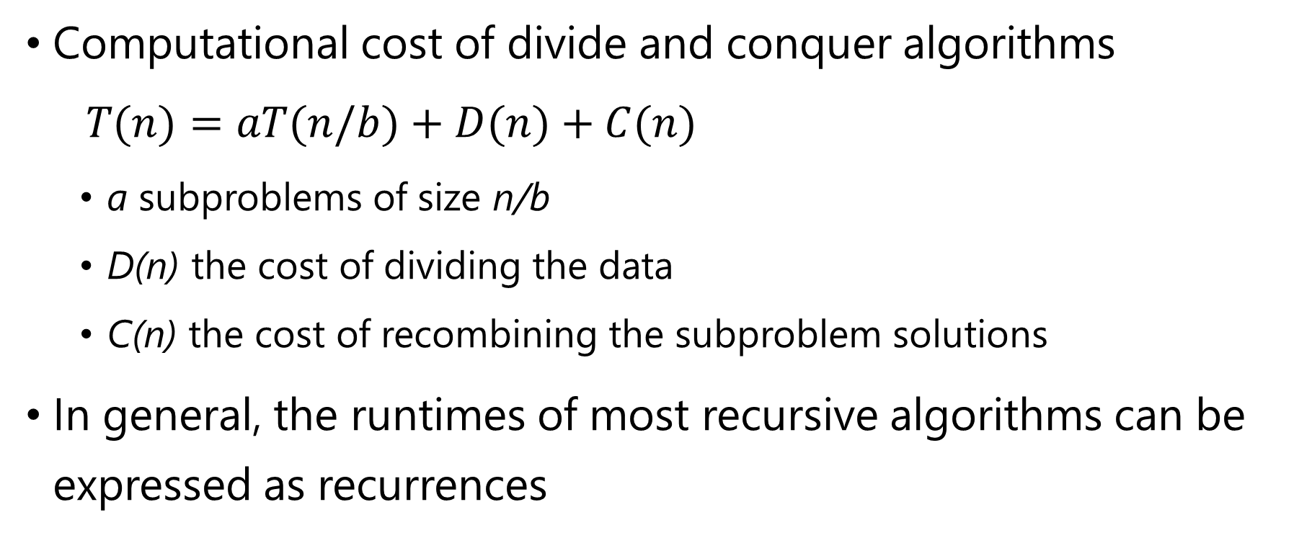
Why are we interested in recurrences?
Computational cost of divide and conquer algorithms
$$T(n)=aT(n/b)+D(n)+C(n)$$
a subproblems of size n/b
D(n) the cost of dividing the data
C(n) the cost of recombining the subproblem solutions
In general, the runtimes of most recursive algorithms can be expressed as recurrences

Slide 18
The challenge
Recurrences are often easy to define because they mimic the structure of the program
But… they do not directly express the computational cost, i.e. n, n², …
We want to remove self-recurrence and find a more understandable form for the function

Slide 19
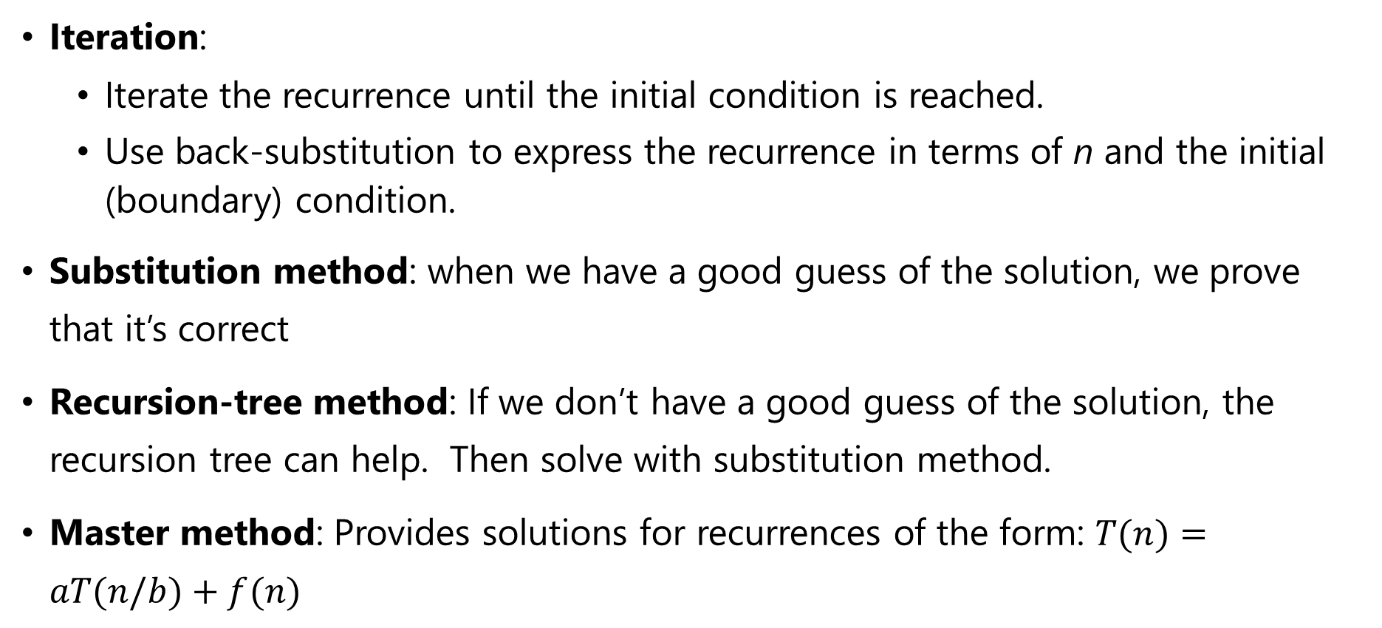
Three Approaches
Iteration:
Iterate the recurrence until the initial condition is reached.
Use back-substitution to express the recurrence in terms of n and the initial (boundary) condition.
Substitution method: when we have a good guess of the solution, we prove that it’s correct
Recursion-tree method: If we don’t have a good guess of the solution, the recursion tree can help. Then solve with substitution method.
Master method: Provides solutions for recurrences of the form: $T(n)=aT(n/b)+f(n)$

Slide 20
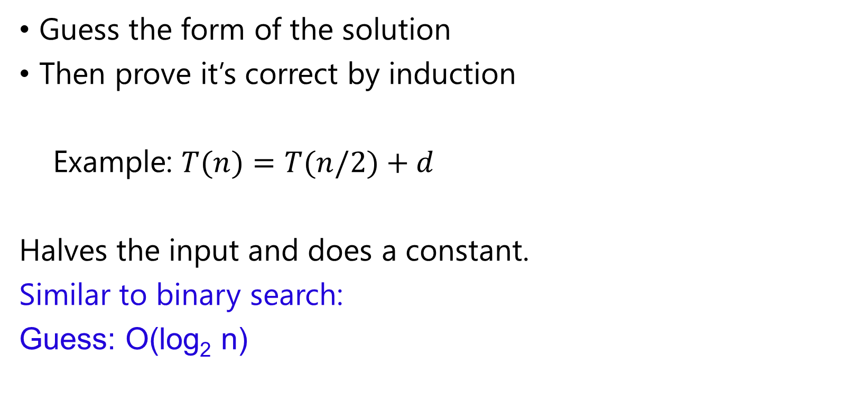
Substitution method
Guess the form of the solution
Then prove it’s correct by induction
Example: $T(n)=T(n/2)+d$
Halves the input and does a constant.
Similar to binary search:
Guess: O(log₂ n)
Guess?

Slide 21

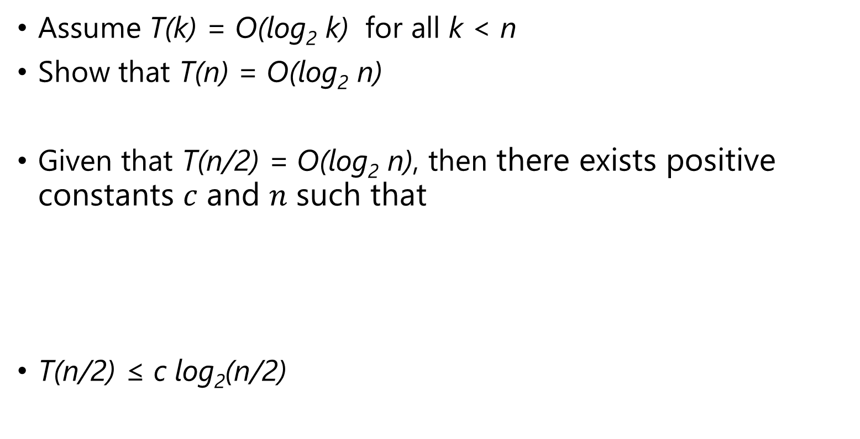
$$T(n)=T(n/2)+d$$
Assume T(k) = O(log₂ k) for all k < n
Show that T(n) = O(log₂ n)
Given that T(n/2) = O(log₂ n), then $\text{there} \text{exists} \text{positive} \text{constants} c \text{and} n \text{such} \text{that}$
T(n/2) ≤ c log₂(n/2)
$$O(g(n))=\left\{\begin{matrix}f(n): & \begin{aligned}& \\ &0≤f(n)≤cg(n) \text{for} \text{all} n≥n_{0}\end{aligned}\end{matrix}\right\}$$

Slide 22
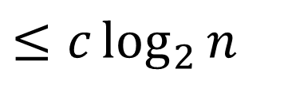
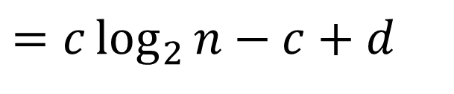
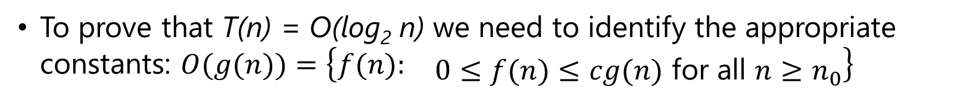
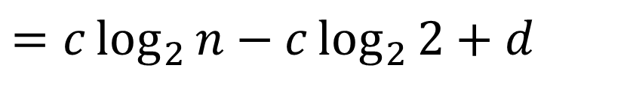
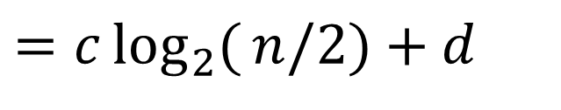
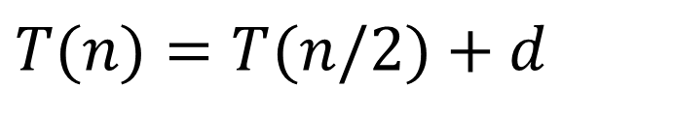
$$Example 1: T(n)=T(n/2)+d$$
To prove that T(n) = O(log₂ n) we need to identify the appropriate constants: $O(g(n))=\left\{\begin{matrix}f(n): & \begin{aligned}& \\ &0≤f(n)≤cg(n) \text{for} \text{all} n≥n_{0}\end{aligned}\end{matrix}\right\}$
i.e. some constant c such that T(n) ≤ c log₂ n
$$T(n)=T(n/2)+d$$
$$=c\log_{2}{(}n/2)+d$$
$$=c\log_{2}{n}−c\log_{2}{2}+d$$
$$=c\log_{2}{n}−c+d$$
residual
$$≤c\log_{2}{n}$$
if c ≥ d

Slide 23
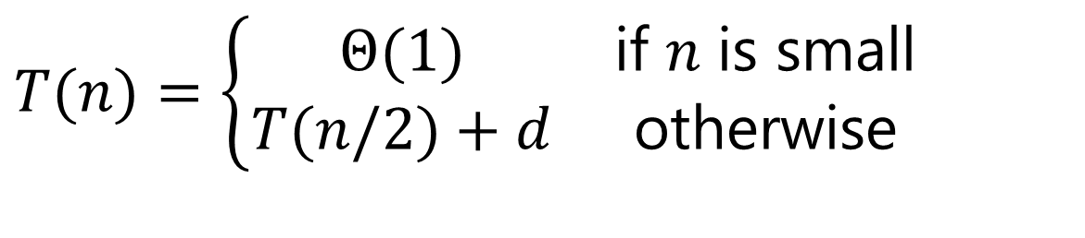
Base case?
For an inductive proof we need to show two things:
Assuming it’s true for k < n show it’s true for n
Show that it holds for some base case
What is the base case in our situation?
$$T(n)=\left\{\begin{matrix}Θ(1) & \text{if} n \text{is} \text{small} \\ T(n/2)+d & \text{otherwise}\end{matrix}\right.$$

Slide 24
$$Example 2: T(n)=T(n−1)+n$$
Guess the solution?
At each iteration, does a linear amount of work (i.e. iterate over the data) and reduces the size by one at each step
O(n²)
Assume T(k) = O(k²) for all k < n
again, this implies that T(n-1) = c(n-1)²
Show that T(n) = O(n²), i.e. T(n) ≤ cn²

Slide 25

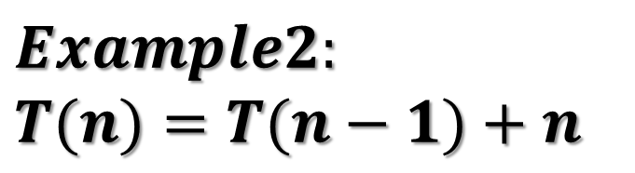
$$Example2:$$
$$T(n)=T(n−1)+n$$
$$=c(n−1)^{2}+n$$
residual
Guess: O(n²)
if
Which holds for any c ≥1 for n ≥1

Slide 26
$$Example 3: T(n)=2T(n/2)+n$$
Guess the solution?
Recurses into 2 sub-problems that are half the size and performs some operation on all the elements
O(n log n)
What if we guess wrong, e.g. O(n²)?
Assume T(k) = O(k²) for all k < n
again, this implies that T(n/2) = c(n/2)²
Show that T(n) = O(n²)

Slide 27
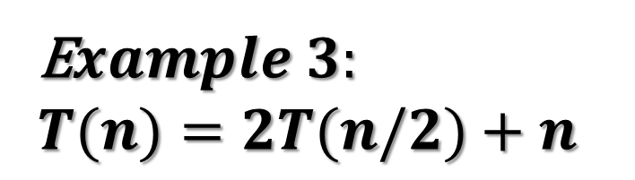

E$xample 3:$
$$T(n)=2T(n/2)+n$$
$$=2c(n/2)^{2}+n$$
residual
Guess₁: O(n²)
if
overkill?

Slide 28
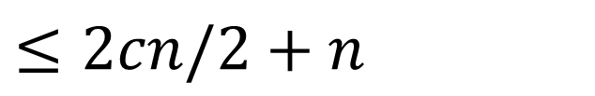
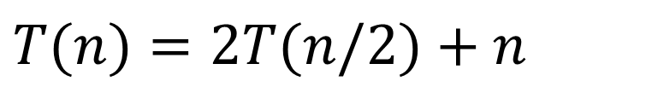
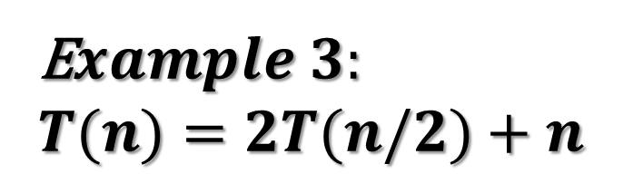
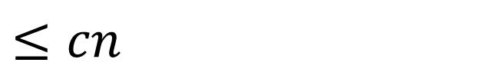

Assume T(k) = O(k) for all k < n
again, this implies that T(n/2) ≤ c
Show that T(n) = O(n)
E$xample 3:$
$$T(n)=2T(n/2)+n$$
$$T(n)=2T(n/2)+n$$
$$≤2cn/2+n$$
$$=cn+n$$
Guess₂: O(n)
$$≤cn$$
factor of n so we can just roll it in?
Must prove the exact form!
cn + n ≤ cn ??

Slide 29






$$T(n)=2T(n/2)+n$$
E$xample 3:$
$$T(n)=2T(n/2)+n$$
$$=2cn/2\log{(}n/2)+n$$
$$=cn(\log_{2}{n}−\log_{2}{2})+n$$
$$=cn\log_{2}{n}−cn+n$$
Guess₃: O(n log n)
residual
$$=cn\log_{2}{n}$$
if cn ≥ n, c > 1

Slide 30

Changing variables
$$T(n)=2T(\sqrt{n})+\log{n}$$
We can do a variable change: let m = log n
If m = log n then n = 2^{m}
$$T(2^{m})=2T(2^{m/2})+m$$
Now, let S(m) = T(2^{m})
$$S\left(m\right)=2S(m/2)+m$$

Slide 31





Changing variables: [ m = log n ]
E$xample 4:$
$$T\left(n\right)=2T\left(\sqrt{n}\right)+\log{n}$$
$$S(m)=2S(m/2)+m$$
$$S(m)=2S(m/2)+m$$
$$=O(m\log{m})$$
$$T\left(n\right)=T\left(2^{m}\right)$$
Previous example
substituting m = log n
Guess₃: O(m log m)
$$T(n)=O(\log{n}\operatorname{loglog}{n})$$

Slide 32

Recursion Tree
Guessing the answer can be difficult
$T(n)=3T(n/4)+n^{2}$
$T(n)=T(n/3)+2T(2n/3)+cn$

Slide 33
The Recursion Tree Approach
Draw out the cost of the tree at each level of recursion
Sum up the cost of the levels of the tree
Find the cost of each level with respect to the depth
Figure out the depth of the tree
Figure out (or bound) the number of leaves
Verify your answer using the substitution method

Slide 34







The Recursion Tree Approach
$$Example: T(n)=3T(n/4)+n^{2}$$
Level
Cost
c n²
0
cn²
$$T\left(\frac{n}{4}\right)$$
$$T\left(\frac{n}{4}\right)$$
$$T\left(\frac{n}{4}\right)$$
$${c\left(\frac{n}{4}\right)}^{2}$$
$${c\left(\frac{n}{4}\right)}^{2}$$
$${c\left(\frac{n}{4}\right)}^{2}$$
1
$$3c\frac{n2}{42}$$

Slide 35


The Recursion Tree Approach
Step
0 | $$n$$ | $$cn2$$
1 | $$\frac{n}{41}$$ | $$c\frac{n2}{\left(41\right)2}$$
2 | $$\frac{n}{42}$$ | $$c\frac{n2}{\left(42\right)2}$$
3 | $$\frac{n}{43}$$ | $$c\frac{n2}{\left(43\right)2}$$
4 | $$\frac{n}{44}$$ | $$c\frac{n2}{\left(44\right)2}$$
$$Example:$$
$$T(n)=3T(n/4)+n^{2}$$

Slide 36

























$$T(n)=3T(n/4)+n^{2}$$
$$cn2$$
Cost
$$31c{\left(\frac{n}{4^{1}}\right)}^{2}$$
$$c\frac{n2}{42}$$
$$c\frac{n2}{42}$$
$$c\frac{n2}{42}$$
1
$$32c{\left(\frac{n}{4^{2}}\right)}^{2}$$
$$c{\left(\frac{n}{4^{2}}\right)}^{2}$$
$$c{\left(\frac{n}{4^{2}}\right)}^{2}$$
$$c{\left(\frac{n}{4^{2}}\right)}^{2}$$
$$c{\left(\frac{n}{4^{2}}\right)}^{2}$$
$$c{\left(\frac{n}{4^{2}}\right)}^{2}$$
$$c{\left(\frac{n}{4^{2}}\right)}^{2}$$
$$c{\left(\frac{n}{4^{2}}\right)}^{2}$$
$$c{\left(\frac{n}{4^{2}}\right)}^{2}$$
$$c{\left(\frac{n}{4^{2}}\right)}^{2}$$
2
3
$$33c{\left(\frac{n}{4^{3}}\right)}^{2}$$
$$c{\left(\frac{n}{4^{3}}\right)}^{2}$$
$$c{\left(\frac{n}{4^{3}}\right)}^{2}$$
$$c{\left(\frac{n}{4^{3}}\right)}^{2}$$
$$3i c{\left(\frac{n}{4^{i}}\right)}^{2}$$
i
$$c{\left(\frac{n}{4^{i}}\right)}^{2}$$
$$c{\left(\frac{n}{4^{i}}\right)}^{2}$$
$$c{\left(\frac{n}{4^{i}}\right)}^{2}$$
$$Cost at level i=3i c{\left(\frac{n}{4^{i}}\right)}^{2}$$

Slide 37












$$T(n)=3T(n/4)+n^{2}$$
$Cost at ith level=3i c$ ${\left(\frac{n}{4^{i}}\right)}^{2}$
$$Cost of each node$$
$$Number of nodes at level i$$
$$Reccursion stops at T\left(1\right) i.e\frac{n}{4^{i}}=1$$
$$\log{\frac{n}{4i}}=0$$
$$Number of leaf nodes:$$
$$\log{n}−\log{4i}=0$$
$$=3i$$
$$\log{n}−i\log{4}=0$$
$$=3^{\log_{4}{n}}$$
$$i=\frac{\log{n}}{\log{4}}=\log_{4}{n}$$

Slide 38



















$$T(n)=3T(n/4)+n^{2}$$
$$cn2$$
$$c\frac{n2}{42}$$
$$c\frac{n2}{42}$$
$$c\frac{n2}{42}$$
$$c\frac{n2}{\left(42\right)2}$$
$$c\frac{n2}{\left(42\right)2}$$
$$c\frac{n2}{\left(42\right)2}$$
$$c\frac{n2}{\left(42\right)2}$$
$$c\frac{n2}{\left(42\right)2}$$
$$c\frac{n2}{\left(42\right)2}$$
$$c\frac{n2}{\left(42\right)2}$$
$$c\frac{n2}{\left(42\right)2}$$
$$c\frac{n2}{\left(42\right)2}$$
$$\log_{4}{n}$$
$$T(1)$$
$$T(1)$$
$$T(1)$$
$$3^{\log_{4}{n}}$$

Slide 39










$$Cost at level d=3d c\frac{n2}{\left(42\right)d}$$
Total Cost
$$T(n)=cn^{2}+\frac{3}{16}cn^{2}+{\left(\frac{3}{16}\right)}^{2}cn^{2}+...+{\left(\frac{3}{16}\right)}^{d−1}cn^{2}+Θ(3^{\log_{4}{n}})$$
$$=cn^{2}\sum_{i=0}^{\log_{4}{n}−1}{{\left(\frac{3}{16}\right)}^{i}}+Θ(3^{\log_{4}{n}})$$
$$\sum_{k=0}^{∞}{x^{k}}=\frac{1}{1−x}$$
$$<cn^{2}\sum_{i=0}^{∞}{{\left(\frac{3}{16}\right)}^{i}}+Θ(3^{\log_{4}{n}})$$
$${since 3}^{\log_{4}{n}}=n^{\log_{4}{3}}$$
let x = 3/16
$$=\frac{1}{1−(3/16)}cn^{2}+Θ(3^{\log_{4}{n}})$$
$$T(n)=\frac{16}{13}cn^{2}+Θ(n^{\log_{4}{3}})$$
$$=\frac{16}{13}cn^{2}+Θ(3^{\log_{4}{n}})$$
$$T(n)=O(n^{2})$$

Slide 40


Verify solution using substitution
$$T(n)=3T\left(\frac{n}{4}\right)+n^{2}$$
Assume T(k) = O(k²) for all k < n
Show that T(n) = O(n²)
Given that T$\left(\frac{n}{4}\right)$= O$\left({\left(\frac{n}{4}\right)}^{2}\right)$, then
$O(g(n))=\left\{\begin{matrix}f(n): & \begin{aligned}&\text{there} \text{exists} \text{positive} \text{constants} c \text{and} n \text{such} \text{that} \\ &0≤f(n)≤cg(n) \text{for} \text{all} n≥n_{0}\end{aligned}\end{matrix}\right\}$
T$\left(\frac{n}{4}\right)$ ≤ c${\left(\frac{n}{4}\right)}^{2}$

Slide 41






Verify solution using substitution
$$T(n)=3T(\frac{n}{4})+n^{2}$$
To how that T(n) = O(n²) we need to identify the appropriate constants:
$$=3c(\frac{n}{4})^{2}+n^{2}$$
$$=cn^{2}3/16+n^{2}$$
$$\begin{aligned}if f\left(n\right)=O\left(g\left(n\right)\right) then \\ ∃ c \text{and} n \text{such} \text{that} such that \\ \begin{aligned}& \\ &0≤f(n)≤cg(n) ∀n≥n_{0}\end{aligned}\end{aligned}$$
$$≤cn^{2}$$
if $c≥\frac{16}{13}$
a positive constant c such that
T(n) ≤ cn²

Slide 42

Master’s method
“Cookbook” for solving recurrences of the form: $T(n)=aT\left(\frac{n}{b}\right)+f(n)$
where, a ≥ 1, b > 1, and f(n) > 0
Idea: compare f(n) with n^{log}_{b}ª
f(n) is asymptotically smaller or larger than n^{log}_{b}ª by a polynomial factor n^{ε}
f(n) is asymptotically equal with n^{log}_{b}ª

Slide 43

Master’s method
“Cookbook” for solving recurrences of the form: $T(n)=aT\left(\frac{n}{b}\right)+f(n)$
where, a ≥ 1, b > 1, and f(n) > 0
Case 1: if f(n) = O(n^{log}_{b}^{a -ε}) for some ε > 0, then: T(n) = Θ(n^{log}_{b}ª)
Case 2: if f(n) = Θ(n^{log}_{b}ª), then: T(n) = Θ(n^{log}_{b}ª lgn)
Case 3: if f(n) = Ω(n^{log}_{b}^{a +ε}) for some ε > 0, and if
af(n/b) ≤ cf(n) for some c < 1 and all sufficiently large n, then:
T(n) = Θ(f(n))
regularity condition

Slide 44
Examples
T(n) = 2T(n/2) + n
Case 1: if f(n) = O(n^{log}_{b}^{a -ε}) for some ε > 0, then: T(n) = Θ(n^{log}_{b}ª)
Case 2: if f(n) = Θ(n^{log}_{b}ª), then: T(n) = Θ(n^{log}_{b}ª lgn)
Case 3: if f(n) = Ω(n^{log}_{b}^{a +ε}) for some ε > 0, and if af(n/b) ≤ cf(n) for some c < 1 and all sufficiently large n, then: T(n) = Θ(f(n))
a = 2, b = 2, log₂2 = 1
Compare n^{log}₂² with f(n) = n
⇒ f(n) = Θ(n) ⇒ Case 2
⇒ T(n) = Θ(nlgn)

Slide 45
Examples
T(n) = 2T(n/2) + n²
Case 1: if f(n) = O(n^{log}_{b}^{a -ε}) for some ε > 0, then: T(n) = Θ(n^{log}_{b}ª)
Case 2: if f(n) = Θ(n^{log}_{b}ª), then: T(n) = Θ(n^{log}_{b}ª lgn)
Case 3: if f(n) = Ω(n^{log}_{b}^{a +ε}) for some ε > 0, and if af(n/b) ≤ cf(n) for some c < 1 and all sufficiently large n, then: T(n) = Θ(f(n))
a = 2, b = 2, log₂2 = 1
Compare n with f(n) = n²
⇒ f(n) = Ω(n^{1+ε}) ⇒ Case 3 verify regularity cond.
a f(n/b) ≤ c f(n)
⇔ 2 n²/4 ≤ c n² ⇒ c = ½ is a solution (c<1)
⇒ T(n) = Θ(n²)

Slide 46

Examples (cont.)
$$\text{T}\text{(}\text{n}\text{) = 2}\text{T}\text{(}\text{n}\text{/2) +}\sqrt{n}$$
Case 1: if f(n) = O(n^{log}_{b}^{a -ε}) for some ε > 0, then: T(n) = Θ(n^{log}_{b}ª)
Case 2: if f(n) = Θ(n^{log}_{b}ª), then: T(n) = Θ(n^{log}_{b}ª lgn)
Case 3: if f(n) = Ω(n^{log}_{b}^{a +ε}) for some ε > 0, and if af(n/b) ≤ cf(n) for some c < 1 and all sufficiently large n, then: T(n) = Θ(f(n))
a = 2, b = 2, log₂2 = 1
Compare n with f(n) = n^{1/2}
⇒ f(n) = O(n^{1-ε}) Case 1
⇒ T(n) = Θ(n)

Slide 47
Examples
T(n) = 3T(n/4) + nlgn
Case 1: if f(n) = O(n^{log}_{b}^{a -ε}) for some ε > 0, then: T(n) = Θ(n^{log}_{b}ª)
Case 2: if f(n) = Θ(n^{log}_{b}ª), then: T(n) = Θ(n^{log}_{b}ª lgn)
Case 3: if f(n) = Ω(n^{log}_{b}^{a +ε}) for some ε > 0, and if af(n/b) ≤ cf(n) for some c < 1 and all sufficiently large n, then: T(n) = Θ(f(n))
a = 3, b = 4, log₄3 = 0.793
Compare n^{0.793} with f(n) = nlgn
f(n) = Ω(n^{log}₄^{3+ε}) Case 3
Check regularity condition:
3∗(n/4)lg(n/4) ≤ (3/4)nlgn = c ∗f(n), c=3/4
⇒T(n) = Θ(nlgn)

Slide 48
Examples
T(n) = 2T(n/2) + nlgn
Case 1: if f(n) = O(n^{log}_{b}^{a -ε}) for some ε > 0, then: T(n) = Θ(n^{log}_{b}ª)
Case 2: if f(n) = Θ(n^{log}_{b}ª), then: T(n) = Θ(n^{log}_{b}ª lgn)
Case 3: if f(n) = Ω(n^{log}_{b}^{a +ε}) for some ε > 0, and if af(n/b) ≤ cf(n) for some c < 1 and all sufficiently large n, then: T(n) = Θ(f(n))
a = 2, b = 2, log₂2 = 1
Compare n with f(n) = nlgn
seems like case 3 should apply
f(n) must be polynomially larger by a factor of n^{ε}
In this case it is only larger by a factor of lgn

Slide 49






Master Method Review
Exercise: $T(n)=aT\left(\frac{n}{b}\right)+f(n)$
$$\text{if} f(n)=O(n^{\log_{b}{a}−ε}) \text{for} ε>0, \text{then}$$
$$T(n)=Θ(n^{\log_{b}{a}})$$
$$\text{if} f\left(n\right)=Θ\left(n^{\log_{b}{a}}\right), \text{then}$$
$$T(n)=Θ(n^{\log_{b}{a}}\log{n})$$
$$\text{if} f\left(n\right)=Ω\left(n^{\log_{b}{a}+ε}\right) \text{for} ε>0 \text{and}$$
$$af\left(\frac{n}{b}\right)≤cf\left(n\right) \text{for} c<1 \text{then}$$
$$T(n)=Θ(f(n))$$

Slide 50



$$f\left(n\right)$$
$$=$$
$$O(n^{2−ε})$$
Case 1: if f(n) = O(n^{log}_{b}^{a -ε}) for some ε > 0, then: T(n) = Θ(n^{log}_{b}ª)
Case 2: if f(n) = Θ(n^{log}_{b}ª), then: T(n) = Θ(n^{log}_{b}ª lgn)
Case 3: if f(n) = Ω(n^{log}_{b}^{a +ε}) for some ε > 0, and if af(n/b) ≤ cf(n) for some c < 1 and all sufficiently large n, then: T(n) = Θ(f(n))
$a$ = b = f(n) =
16
4
n
$$Compare n^{2} with f(n)$$
Case 1:
T(n) = Θ(n^{log}_{b}ª)
T(n) = Θ(n²)

Slide 51






$$f\left(n\right)$$
$$=$$
$$O(n^{2−ε})$$
Case 1: if f(n) = O(n^{log}_{b}^{a -ε}) for some ε > 0, then: T(n) = Θ(n^{log}_{b}ª)
Case 2: if f(n) = Θ(n^{log}_{b}ª), then: T(n) = Θ(n^{log}_{b}ª lgn)
Case 3: if f(n) = Ω(n^{log}_{b}^{a +ε}) for some ε > 0, and if af(n/b) ≤ cf(n) for some c < 1 and all sufficiently large n, then: T(n) = Θ(f(n))
$a$ = b = f(n) =
1
2
2^{n}
$$Compare n^{0} with f(n)$$
Case 3:
Check condition:
$$\text{is} 2^{n/2}≤c2^{n} \text{for} c<1?$$
$$2^{n/2}≤(1/2)2^{n}$$
$$2^{n/2}≤2^{−1}2^{n}$$
$$2^{n/2}≤2^{n−1}$$
T(n) = Θ(2^{n})

Slide 52


$$f\left(n\right)$$
$$=$$
$$O(n^{2−ε})$$
Case 1: if f(n) = O(n^{log}_{b}^{a -ε}) for some ε > 0, then: T(n) = Θ(n^{log}_{b}ª)
Case 2: if f(n) = Θ(n^{log}_{b}ª), then: T(n) = Θ(n^{log}_{b}ª lgn)
Case 3: if f(n) = Ω(n^{log}_{b}^{a +ε}) for some ε > 0, and if af(n/b) ≤ cf(n) for some c < 1 and all sufficiently large n, then: T(n) = Θ(f(n))
$a$ = b = f(n) =
2
2
n
$$Compare n with f(n)$$
Case 2:
T(n) = Θ($n\log{n}$)

Slide 53





$$f\left(n\right)$$
$$=$$
$$O(n^{2−ε})$$
Case 1: if f(n) = O(n^{log}_{b}^{a -ε}) for some ε > 0, then: T(n) = Θ(n^{log}_{b}ª)
Case 2: if f(n) = Θ(n^{log}_{b}ª), then: T(n) = Θ(n^{log}_{b}ª lgn)
Case 3: if f(n) = Ω(n^{log}_{b}^{a +ε}) for some ε > 0, and if af(n/b) ≤ cf(n) for some c < 1 and all sufficiently large n, then: T(n) = Θ(f(n))
$a$ = b = f(n) =
16
4
n!
$$Compare n^{2} with f(n)$$
Case 3:
Check condition:
$$\text{is} 16(n/4)!≤cn! \text{for} c<1?$$
Let c = ¹/₂
$$cn!=\frac{1}{2}n!>(n/2)!$$
$$16(n/4)!≤(n/2)!<\frac{1}{2}n!$$
T(n) = Θ(n!)

Slide 54




$$f\left(n\right)$$
$$=$$
$$O(n^{2−ε})$$
Case 1: if f(n) = O(n^{log}_{b}^{a -ε}) for some ε > 0, then: T(n) = Θ(n^{log}_{b}ª)
Case 2: if f(n) = Θ(n^{log}_{b}ª), then: T(n) = Θ(n^{log}_{b}ª lgn)
Case 3: if f(n) = Ω(n^{log}_{b}^{a +ε}) for some ε > 0, and if af(n/b) ≤ cf(n) for some c < 1 and all sufficiently large n, then: T(n) = Θ(f(n))
$a$ = b = f(n) =
$$\sqrt{2}$$
2
$$\log{n}$$
$$Compare \sqrt{n} with f(n)$$
Case 1:
T(n) = Θ($\sqrt{n}$)

Slide 55




$$f\left(n\right)$$
$$=$$
$$O(n^{2−ε})$$
Case 1: if f(n) = O(n^{log}_{b}^{a -ε}) for some ε > 0, then: T(n) = Θ(n^{log}_{b}ª)
Case 2: if f(n) = Θ(n^{log}_{b}ª), then: T(n) = Θ(n^{log}_{b}ª lgn)
Case 3: if f(n) = Ω(n^{log}_{b}^{a +ε}) for some ε > 0, and if af(n/b) ≤ cf(n) for some c < 1 and all sufficiently large n, then: T(n) = Θ(f(n))
$a$ = b = f(n) =
$$4$$
2
$$n$$
$$Compare n2 with f(n)$$
Case 1:
T(n) = Θ($n2$)

Slide 56








Why does the master method work?
At each level, the size of the data is divided by b
$$T(n)=aT(n/b)+f(n)$$
f(n)
f$(n)$
$$a$$
$$af(n/b)$$
f(n/b)
f(n/b)
f(n/b)
$$a$$
$$a$$
$$a$$
Nº of leaves of depth d?
$$a2f(n/b2)$$
f(n/b²)
f(n/b²)
f(n/b²)
f(n/b²)
f(n/b²)
f(n/b²)
f(n/b²)
f(n/b²)
f(n/b²)
Notes:
Geometric Series: Let x ≠ 1 be any constant (independent of n), then for n ≥ 0,
$$\sum_{i=0}^{n}{x^{i}}=x+x^{2}+x^{3}+ …+x^{n}=\frac{x^{\left(n+1\right)}−1}{x−1}$$

Slide 57


$$f\left(n\right)$$
$$=$$
$$O(n^{2−ε})$$
$$T(n)=aT(n/b)+f(n)$$
$$=cf(n)+af(n/b)+a^{2}f(n/b^{2})+...+{ a}^{n−1}f(n/b^{n−1})+Θ(n^{\log_{b}{a}})$$
Case 1: if f(n) = O(n^{log}_{b}^{a -ε}) for some ε > 0, then: T(n) = Θ(n^{log}_{b}ª)
Case 2: if f(n) = Θ(n^{log}_{b}ª), then: T(n) = Θ(n^{log}_{b}ª lgn)
Case 3: if f(n) = Ω(n^{log}_{b}^{a +ε}) for some ε > 0, and if af(n/b) ≤ cf(n) for some c < 1 and all sufficiently large n, then: T(n) = Θ(f(n))
$$Cost=\sum_{i=0}^{\log_{b}{n}−1}{a^{i}f(n/b^{i})}+Θ(n^{\log_{b}{a}})$$
Case 1:
Cost is dominated by the cost of the leaves
$$\sum_{i=0}^{\log_{b}{n}−1}{a^{i}f(n/b^{i})}<Θ(n^{\log_{b}{a}})$$
Case 2:
Cost is evenly distributed across tree
Case 3:
Cost is dominated by the cost of the root

Slide 58

Shortcomings
Why do we care about substitution method and recurrence tree method? Master method is much easier.
Some recurrences don’t fit the mold
$T(n)=T(n/3)+2T(2n/3)+cn$

Slide 59

Other forms of the master method
$$T(n)=aT\left(\frac{n}{b}\right)+O(n^{d})$$
$$T(n)=\left\{\begin{matrix}O(n^{d}) & \text{if} d>\log_{b}{a} \\ O(n^{d}\log{n}) & \text{if} d=\log_{b}{a} \\ O(n^{\log_{b}{a}}) & \text{if} d<\log_{b}{a}\end{matrix}\right.$$

Slide 60
Recurrences

Slide 61
Practice problem
You are given an infinitely long array, where the first n elements contain data and the remaining elements do not. At any given position, you can test whether that element contains data or not. How can you determine n?

